Slide 1

Getting to the end of ourselves…
Have you ever reached the “end of your rope?”
When was the last time you reached the “end of your rope?”
-circumstances against you
-nothing you could do about it
Are you more like Judas or Jonah?
Notes:
How do you respond when faced with difficulties you cannot change?
Severe change of health causing major lifestyle changes
Told you have days, weeks, months to live
Lost a job you worked for years
Spouse had an affair
Spouse wants a divorce
Loved one dies unexpectedly
Diagnosed with Mental illness
Become addicted to something or have re-lapse of addiction
What do you do when you are at your wits end & realize there is absolutely nothing you can do to change the situation?
The first time I can remember being faced with such a circumstance was in 1982 when my parents had to sell their business & divorced.
When life deals you a punch to the gut, how do you respond?
Judas looked inwardly & to others for answers & found none. Mt.27:3-10
Jonah looked inwardly at first, but when his life was in jeopardy he turned to God.

Slide 2
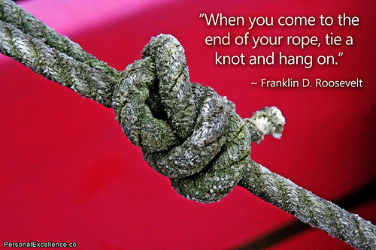
Getting to the end of ourselves…
Where do you look for answers?
Rarely do we look to Jesus first.
Our Father longs to bless us!
-Psa.146 ; 1 Pet 5:7
Again, think of Jonah (2:7-9)
Notes:
There are hundreds of answers to the question that look to ourselves & others for answers to our problems. And most of the time we start looking for answers by relying on our own power or intelligence, or by consulting other people.
But once we realize we are powerless to change our circumstance, then we call on Jesus. It seems like we must get to the end of ourselves before we recognize the real power of Jesus.
Psa.146 ; 1 Pet.5:7
Again, think of Jonah. Initially he didn’t want to do what God told him. But when he was in the belly of the fish for 3 days in the depths of the sea (END OF HIS ROPE) he came to realize he had no power over his life & if wanted to live he had to turn completely to God.
Jonah 2:1-9 indicates that he offered himself as a sacrifice to God and was committed
to the will of the Lord.

Slide 3
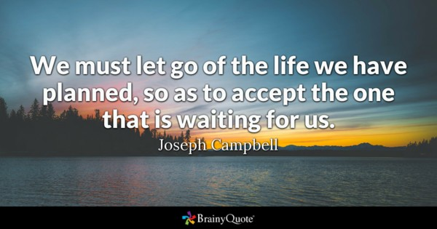
Getting to the end of ourselves…
Not good at letting go & letting God.
Countercultural & counterintuitive to give up control.
Discipleship =self denial (Lk.9:23-24)
Most people turned off by this…
Why must we deny ourselves?
Notes:
Part of our difficulty with this is because we aren’t very good at giving up control of our lives. The world says to take the reins and forge our own way, and to do otherwise just doesn’t feel right. But this is part of what discipleship asks of us
–Luke 9:23-24
Reaching the end of ourselves is a battle we must fight daily & it’s worth the effort because this is the only way that Jesus can come into our lives fully.
Most people are turned off by this way of thinking about life. For some, they claim to be following Jesus but without denying themselves.
Their religion is false –Lk6:46
Others don’t see a need for Jesus. They think life is only about fleshly things
–Matt.6:19-34
So, why does Jesus wants us to be different than everybody else?
Jesus wants us to see that blessings begin & fulfillment is found in the least likely place –the end of ourselves! Jeremiah 10:23

Slide 4
Notes:
Jesus came to bring a way of life that lead to an abundant life –Jn 10:10
In this context He speaks to some Pharisees who thought they were living an abundant life, but they had not denied themselves or fully submitted to God.
In Jn 9 He healed a man born blind on the Sabbath and the Pharisees called Jesus a sinner (v24). The man born blind was at the “end of his rope”. There was nothing he could do to change his blindness, but Jesus healed him to show Himself to be the Son of God & the Light of the world.
In contrast to the blind man, the Pharisees thought they were righteous based on law keeping & couldn’t see their true circumstances.
Notice what Jesus says to them in vs 39-41.
Jesus is saying the He came to bring light to the world so that we could see our spiritual blindness & be rescued from the darkness of sin. It is in this context that Jesus speaks of Himself first as the door of the sheep, then as the Good Shepherd. He was telling the Pharisees then & is telling is now that there are no shortcuts to an abundant life.

Slide 5
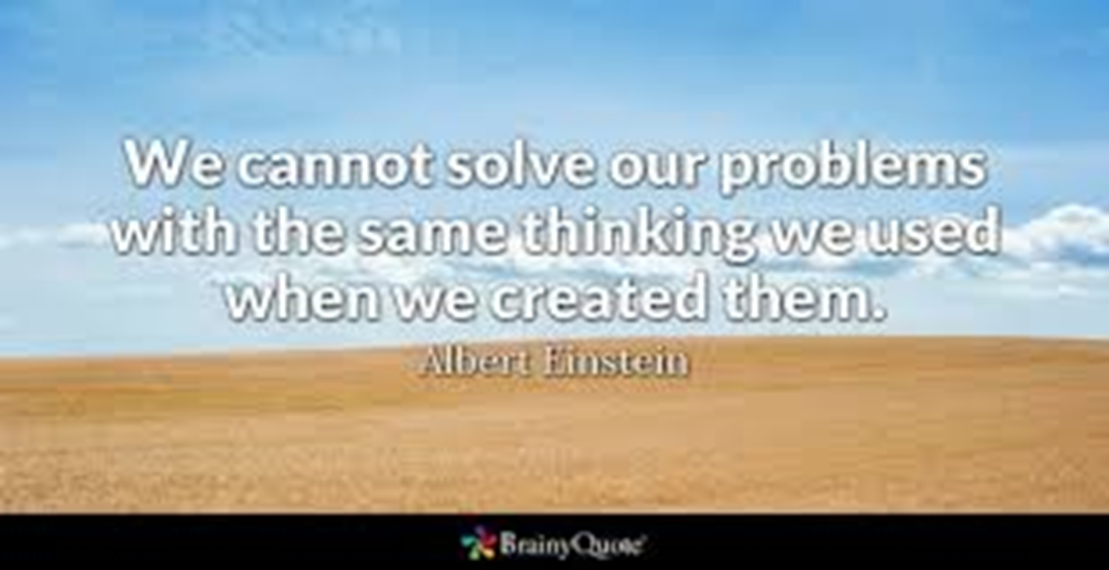
Getting to the end of ourselves…
Once we realize we are powerless…
Not strong enough, smart enough, or talented enough to live in a way that leads to eternal life.
Must come to the end of ourselves.
Notes:
Once we realize we are powerless to direct our own steps through this life we will understand that we are not strong enough, smart enough, or talented enough to live in a way that leads to eternal life.
This is not a new problem. Jews in the first century believed that b/c they were descendants of Abraham they were the elect of God & on the path to Heaven. Then along came a carpenter’s son who turned that notion upside down. The gospel of John introduces Jesus as the True Light (1:9) & the Lamb of God (1:29). To substantiate these claims John records 7 miracles of Jesus.
Ch 2 He changes water to wine
Ch 4 He heals the son of the nobleman
Ch 5 He heals the lame man at the pool
It was here that the Jews began to oppose Jesus b/c He healed on the Sabbath. It was also here that Jesus began to expose the error of their thinking –Jn5:24, 37-40
In other words, they have not come to the end of themselves. They are trusting their own strength, intelligence, & talent, all of which prevented them from believing that Jesus was the fulfillment of the very scriptures they searched for eternal life!
We must come to the end of ourselves to see who Jesus is & understand our need for Him.

Slide 6
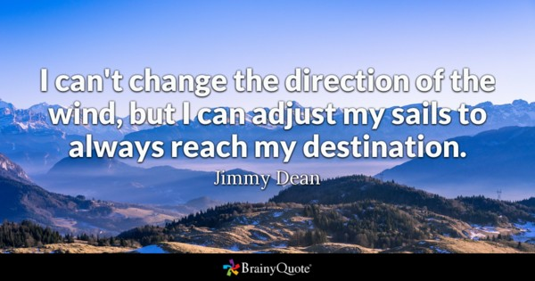
Getting to the end of ourselves…
Jesus is the way to an abundant life.
We must conform to His way.
Shift focus from physical to spiritual
No shortcuts to the abundant life.
Notes:
In Jn 6 many followed Jesus b/c of the signs He performed (vs2). On this occasion He fed >5,000 people and they declared Him to be the Prophet of God. The next day people went looking for Jesus & He tells them not to seek Him b/c of the food He provided, but to seek Him b/c He is the way to eternal life! (6:26-27)
This was a challenge to their perspective about life. They felt secure in their relationship with God, but their focus here was entirely physical. The challenge of Jesus was to see beyond self in order to see that He was the Son of Man sent from God to give eternal life (vs27).
Their response seems to indicate their interest in learning, but wanting further proof before they believe indicates their inability to grasp the teaching of Jesus (vs.28-31).
Jesus says the work of God is to believe that He was sent from God to bring eternal life. This means more than a simple acknowledgment that Jesus came from God. Believing Jesus means that we must shift the focus of our lives away from ourselves (food) and become spiritually minded (eat bread from Heaven).
Focus on fleshly things lead to death (v49). Focus on Jesus leads to life (v54).

Slide 7

Getting to the end of ourselves…
Why is this difficult? (Jn6:60)
Must be spiritually minded to believe
All at the “end of our rope” & need a Savior
Notes:
It is only difficult to believe in Jesus when the mind is focused on self and fleshly things.
To further emphasize the point, Jesus asks them that if they find that hard to believe what will they believe when they see Him ascend back to Heaven? (vs.62)
A mind focused on physical things causes us to trust in ourselves and fail to see that Jesus was sent from God to bring us eternal life. When we don’t see the real power of Jesus we don’t fully give ourselves to Him.
We’ll trust Him in some areas of our lives, but we want to maintain control in other areas. This is not what it means to get to the end of ourselves. We’re just eating manna that causes us to die in the wilderness (vs49). If were going to face difficulties in this life, let it be for doing what is right.
When we are faced with choosing between following self or following Jesus, let’s be resolved to surrender ourselves to Jesus as Lord & may our mindset be like the apostles when Peter said “Lord, to whom shall we go? You alone have the words of eternal life.” (Jn6:68)

