Slide 1
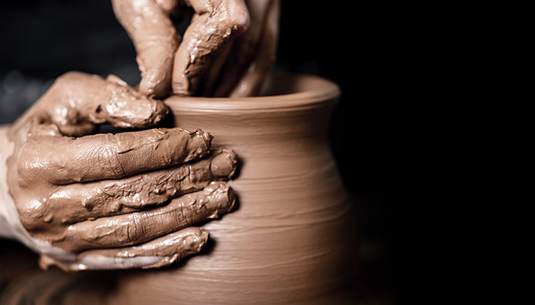
Make Me As Clay
We are the clay, and You our potter;
All of us are the work of Your hand.
Isa. 64:8

Slide 2
Israel was the work of God’s hands
Isa. 64—praise, sin, salvation, appeal
Isa. 65—God’s response
“Behold, I create new heavens and a new earth; and the former things will not be remembered or come to mind. But be glad and rejoice forever in what I create; for behold, I create Jerusalem for rejoicing and her people for gladness.”

Slide 3
Isa. 65:2-7
“I have spread out My hands all day long to a rebellious people,
who walk in the way which is not good, following their own
thoughts, a people who continually provoke Me to My face,
offering sacrifices in gardens and burning incense on bricks;
who sit among graves and spend the night in secret places;
who eat swine’s flesh, and the broth of unclean meat is in
their pots . . . I will repay . . . both their own iniquities and the
iniquities of their fathers together . . .
because they have burned incense on the
mountains and scorned Me on the hills.

Slide 4
Jeremiah 18
The vessel that he was making was spoiled, so he made it into another vessel, as it pleased the
potter to make.

Slide 5
God Redeems Those Who Return
These He creates for His glory – Isa. 43:7
These He forms for Himself – Isa. 43:21

Slide 6
Idols are the works of men’s hands

Slide 7
God Predicted Their Idolatry
Deut. 4:28 – “You will serve gods, the work of men’s hands, wood and stone, which neither see nor hear nor eat or smell.”
Deut. 27:15— “Cursed is the man who makes an idol . . . the work of the hands of the craftsman.”
Deut. 31:29– “After my death you will . . . provoke Him to anger with the work of your hands.”

Slide 8
The essence of self-made religion is to devise within your own heart a plan for worship and then to make with your own hands gods to worship.

Slide 9
Self-made Religion
Solomon
Jereboam
Baasha

Slide 10
Idol worship—the work of men’s hands
2 Kings 19:18; 22:17
2 Chron. 32:19
Isa. 2:8; 17:8; 37:19
Jer. 25:6-7,14; 32:30
Hos. 14:3
Micah 5:13

Slide 11
Psa. 115:4; 135:15-18
Those who make them will become like them.
Blind and Deaf!!!!!!!!!!

Slide 12
We are God’s workmanship created in Christ Jesus
for good works, which God
prepared beforehand so that we
would walk in them.
Eph. 2:10

Slide 13
“Make me as clay in the potter’s hand.
Mold me; make me, as You’d have me be.
Though marred by sin, take full command and
make me as clay in the potter’s hand.”
Mr. and Mrs. Clyde Williams

