Slide 2
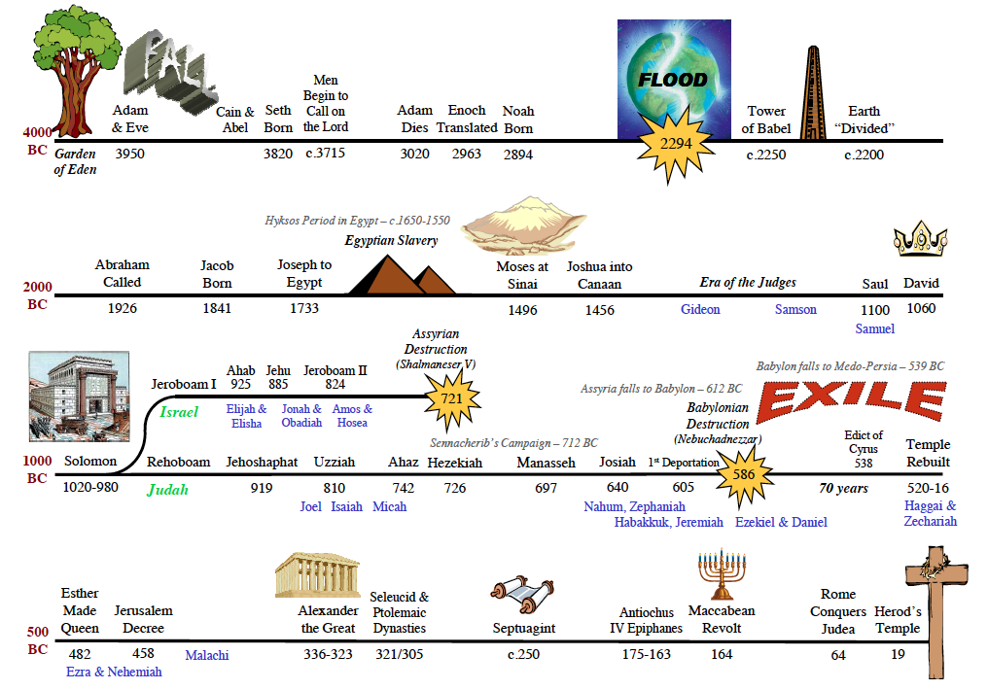
The story is about……
Revelation of God’s eternal plan
Beginning in the Garden of Eden
Sin caused separation b/w God & man
Promise of Redemption Gen 3:15
Unfolding thru Seth, Noah, Shem
3 Promises to Abraham –Gen 12
Promises repeated to Abraham, Isaac, Jacob
Working of God in the lives of their descendants to unfold His plan

Slide 3
DIVIDED KINGDOM
Solomon about to die & kingdom in distress (1Kgs11:9-13)
Rebellion & kingdom divides at his death (1Kgs.12:1-24)
Jeroboam becomes king of 10 northern tribes
Kept the name Israel
Rehoboam becomes king of 2 southern tribes
Would be called Judah (Judah & Benjamin)
From this point through rest of the OT, the people fall farther & farther away from God.

Slide 4
RISE & FALL OF ISRAEL
Jeroboam established new system of worship
New gods, priests, laws, feast days (1Kgs12:25-33)
19 kings in Israel, not one was righteous
Ruling family changed 9 times
Prophets like Elijah, Elisha, Hosea, Amos warned Israel of impending doom
Fell to Assyrians in 722 BC (2Kgs.17:5-6, 7-23)
Israel no longer significant in scheme of redemption.

Slide 5
RISE & FALL OF JUDAH
Existed from 931-586 BC
Some good kings & some bad kings
All kings from tribe of Judah, the lineage of David (Remember Gen.49:8-10)
Worship of God continued in Temple, with priests from tribe of Levi
Prophets: Isaiah, Micah, Jeremiah, Ezekiel, Daniel…

Slide 6
RISE & FALL OF JUDAH
Judah eventually drifted away from God
Fell to Babylonians (2Chr.36:1-21)
606 BC first captives taken from Jerusalem (vs.4-8)
597 BC second group taken (vs.9-10)
586 BC Jerusalem & temple destroyed (vs.11-21)

Slide 7
HAS GOD FORGOTTEN HIS PLAN?
Judah had to be punished, but God did not allow man’s weakness to change His eternal purpose!
Remember the promise to David (2Sam.7:12-16)
Royal line would remain in his family
Ruling family changed 9 times in Israel
Ruling family never changed in Judah!
Punishment part of God’s promise, as were His blessings for faithfulness (2 Sam.7:14-16)

Slide 8
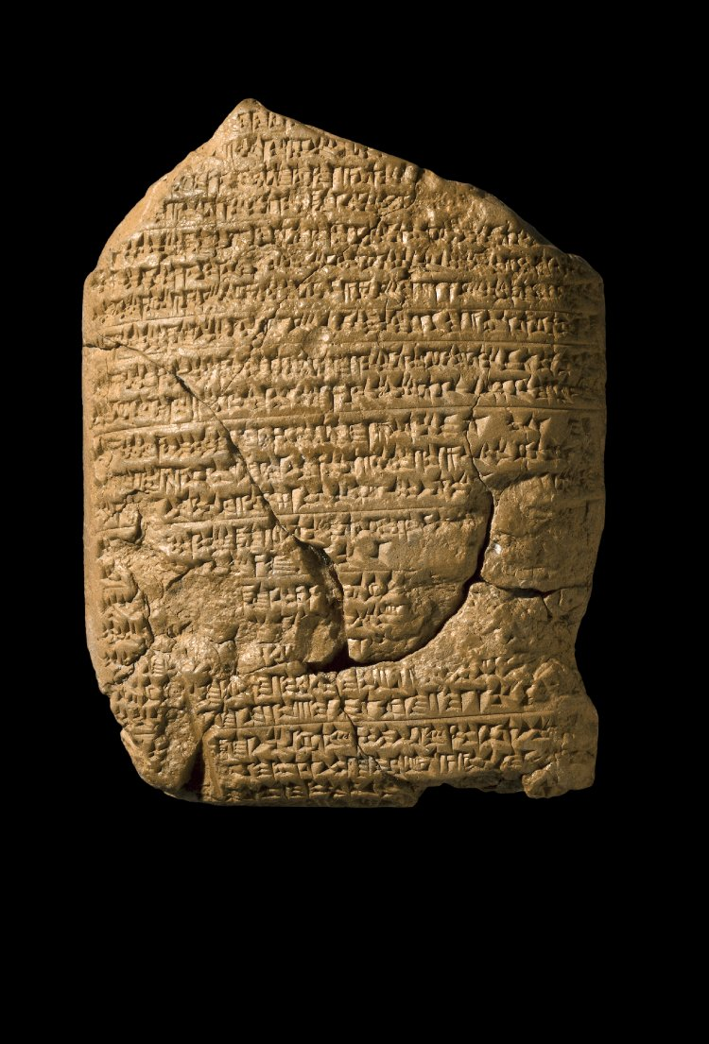
The “Babylonian Chronicle””
Notes:
This first conquest of Jerusalem by Nebuchadnezzar in 597BC is recorded on a clay tablet known as the ‘Babylonian Chronicle’ which can be seen in the British Museum in London.
Such artifacts are not only a testimony to the things recorded in Scripture, but to their accuracy.

Slide 9
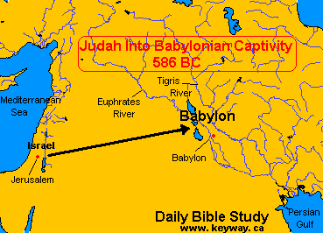
THE TIME OF CAPTIVITY
Daniel & Ezekiel served as God’s prophets during captivity.
Daniel in positions of authority under Nebuchadnezzar, then Darius (Medes/Persians)
Ezekiel lived among the common people

Slide 10
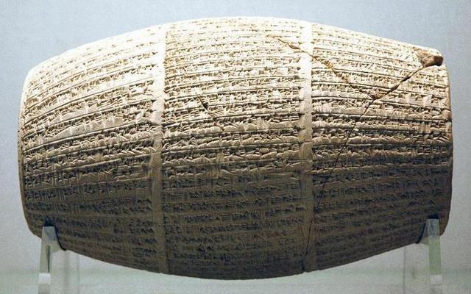
RETURN OF A REMNANT
Prophesied to last 70 yrs (Jer.25:1-12)
God promised a remnant would return
Jer.30:1-3; 50:1-5 (people from Israel & Judah)
539 BC Babylon fell to the Medes & Persians
536 BC King Cyrus released captives (2Chr36; Ezra 1:1-4)
Remember the first captives taken in 606 BC
606-536 = 70 yrs
Cyrus Cylinder
Notes:
On the site of Babylon, archaeologists discovered the Cyrus Cylinder, a clay cylinder with inscriptions which record details about the capture of Babylon by the Persian king Cyrus (539 B.C.).
According to the cuneiform on the Cyrus Cylinder, he was favored by Marduk and the other gods who purposed for Nabonidus and Belshazzar to be dethroned and divine help would be given to Cyrus. Cyrus reestablished their religious practices and was a very benevolent and gracious ruler. He was responsible for the return of the Jews to Jerusalem and the rebuilding of their temple.

Slide 11
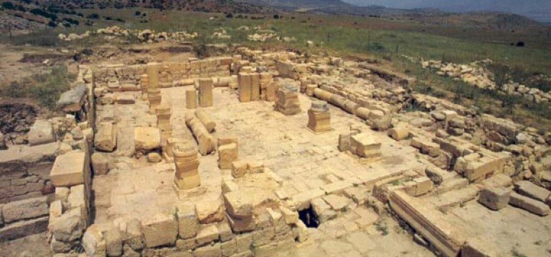
REBUILDING THE TEMPLE
Zerubbabel led first captives back (Ezra 2:2)
Work began on Temple, but soon stopped because of opposition (Ezra 3-4)
Proph. Haggai questions the people (Hag.1:2-4)
Haggai explains reasons for hardships (Hag.1:5-11)

Slide 12
REBUILDING THE TEMPLE
Haggai asks how this temple would compare with the glory of former temple? (Hag.2:3)
He knew it would pale in comparison
God’s glory did not fill this temple (Ezra 6:13-18)
Part of God’s plan to redeem man thru the house of His Son, that is the Church (Hag.2:6-9)
A spiritual temple made up of people from all nations. Not a physical building.
These promises quoted in Heb.12:18-29
Vs.23 indicates it would be accomplished through the line of “Zerubbabel My Servant”. (Mt.1:12,16)

Slide 13
GOD’S FINAL OT WORDS
“Behold, I send My messenger, and he will prepare the way before Me. And the Lord, whom you seek, will suddenly come to His temple…” (Mal.3:1)
“Behold, I send you Elijah the prophet before the coming of the great and dreadful day of the Lord.” (Mal.4:5)
This messenger to prepare the way of the Lord would be John, the baptist.
(Lk.1:13-17; Mk.1:1-8, cf.2Kgs.1:8; Mt.17:9-13)
Notes:
To tie all these things together with this lesson let’s take a look back at what was said when Judah was punished by Babylonian captivity:
2 Chron.36:14-16
The leaders and the people didn’t listen to what God said.
They did the same abominable things the ungodly nations did.
God continually sent them messengers to warn them to repent because of His compassion for them.
But they mocked His messengers and despised His words until there was no remedy and His wrath arose against them!
Dear friends, there is no reason to ever be on the receiving end of God’s wrath. He has given us a remedy through His son Jesus Christ.
Don’t test the patience and longsuffering of God by neglecting or refusing His words.
If we live like the world we’ll be destroyed with it.
His eternal purpose has been revealed and it is the only way to save our souls from eternal destruction. God isn’t going to change His plan to suit us, we must change our ways to conform to the redemptive plan of God.
Who among us is ready to submit to God & receive His salvation?

