Slide 1
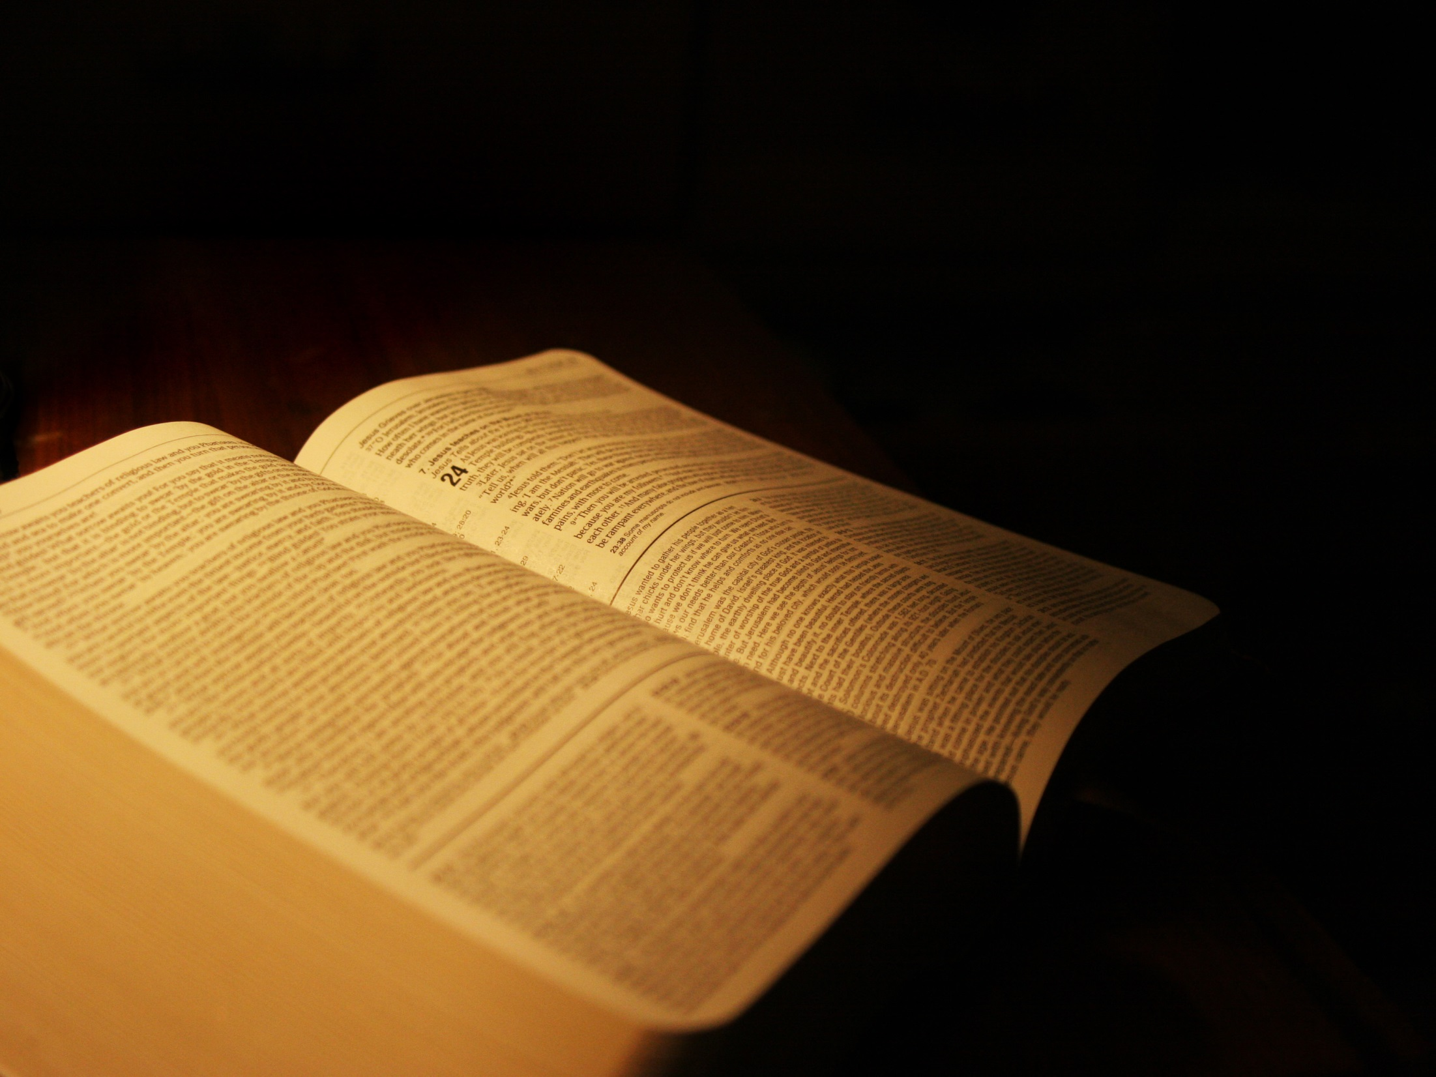
WHAT DOES GOD WANT ?
Abel, on his part also brought of the firstlings of his flock and of their fat portions. And the LORD had regard for Abel and for his offering;
Genesis 4:4 NASB

Slide 2
WHAT DOES GOD WANT ?
“Also you shall observe the Feast of the Harvest of the first fruits of your labors from what you sow in the field; also the Feast of the Ingathering at the end of the year when you gather in the fruit of your labors from the field.
Exodus 23:16 NASB

Slide 3
God Wants The First!
Deuteronomy 26:1-10
Numbers 15:17-21
Exodus 13:1-15
Numbers 3:11-13

Slide 4
God Wants The First!
But seek first His kingdom and His righteousness, and all these things will be added to you.
Matthew 6:33 NASB

Slide 5
God Wants The First!
Exodus 4:22-23
Jeremiah 2:3
Galatians 4:4-7

Slide 6
God Wants The First!
In the exercise of His will He brought us forth by the word of truth, so that we would be a kind of first fruits among His creatures.
James 1:18 NASB

Slide 7
God Wants The First!
But you have come to Mount Zion and to the city of the living God, the heavenly Jerusalem, and to myriads of angels, to the general assembly and church of the firstborn who are enrolled in heaven, and to God, the Judge of all, and to the spirits of the righteous made perfect, and to Jesus, the mediator of a new covenant, and to the sprinkled blood, which speaks better than the blood of Abel.
Hebrews 12:22-24 NASB

Slide 8
Do You Want God?
Luke 9:57-62
Luke 10:38-42

