Slide 1
Rock Solid Faith
A study of messianic prophecies
Notes:
“Question with boldness even the existence of a god; because, if there be one, he must more approve of the homage of reason, than that of blind-folded fear.” Thomas Jefferson
God has created us with intelligence and the ability to reason, weigh the evidence and form reasonable conclusions. He would not have created us with these abilities and then left us without substantial evidence to conclude that He is, that He created everything, that He has given us His Word, and that He sent His Son.
There are over 300 Messianic prophecies and I like to take this time to review in detail each one (ha ha), but first let’s consider what it takes to have a reliable account…

Slide 2
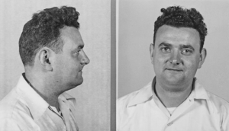
Statistical Reliability
David Greenglass, WWII traitor, worked on the Manhattan Project and sold atomic secrets to the Russians.
Once in Mexico City, Greenglass wrote a note, signing his name “I. Jackson”
After 3 days he was to go to the Plaza de Colon in Mexico City.
He was to stand before the statue of Columbus.
He was to place his middle finger in a guide book.
When he was approached, he was to say it was a magnificent statue and that he was from Oklahoma.
Notes:
After the war, Greenglass fled to Mexico and his conspirators arranged a meeting with the secretary of the Russian ambassador in Mexico City. Proper identification was of utmost importance in arranging this meeting, therefore there were five prearranged signs that were used to identify Greenglass. Upon witnessing these five signs the secretary was to then give him a passport.

Slide 3
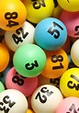
What are the odds?
Odds of winning the combined $999 million jackpots=1 in 88 quadrillion
Odds of winning $345 million Powerball=1 in 292 million
(Population of the U.S. is 325.7 million)
Odds of being struck by lightning=1 in 3,000
Odds of dating a millionaire=1 in 215

Slide 4
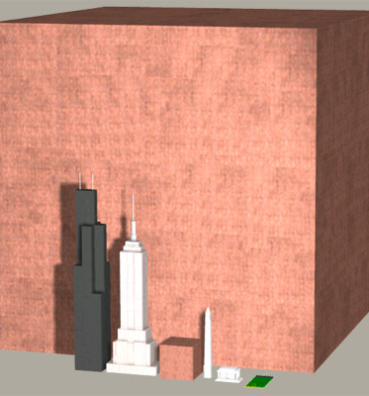
1 quadrillion pennies (1,000,000,000,000,000)
Cube ½ mile wide
Weight ~3 billion tons
$10 trillion, pay nearly ½ of our national debt

Slide 5
Odds of Fulfilling Messianic Prophecies
Odds of being born in Bethlehem=1 in 300,000
Odds of fulfilling only eight messianic prophecies=1 in 10^17
10^17 silver dollars would cover Texas two feet deep
Odds of 48 prophecies fulfilled in one person=1 in 10^157
According to Emile Borel (a renowned French mathematician), once one goes past one chance in 10^50, the probabilities are so small that it is impossible to think that they will ever occur.
There are well over 300 messianic prophecies recorded in scripture.

Slide 6
Earliest Messianic Prophecies
Genesis 3:15
And I will put enmity Between you and the woman, And between your seed and her seed; He shall bruise you on the head, And you shall bruise him on the heel.”
Genesis 12:3
And I will bless those who bless you, And the one who curses you I will curse. And in you all the families of the earth will be blessed.”
Genesis 49:10-Descendant of Judah
II Samuel 7:12, 13-Descendant of David

Slide 7
Birth of the Messiah
Virgin Mother
Isaiah 7:14, Genesis 3:15
Luke 1:35
Birthplace=Bethlehem Ephrathah
Micah 5:2, Matthew 5:4-6
Matthew 2:1-2, Luke 2:4
Flight to Egypt
Numbers 24:8
Matthew 2:13-15
Notes:
“her seed” suggestive of virgin birth, only place I could find referenced where seed of a woman is used
Micah prophesied 700 before Jesus birth
Augustus Caesar commanded a census be performed which is the reason Jesus was born in Bethlehem, otherwise He would have more naturally been born in Nazareth, some 80 miles away.
Because of Herod’s plot to destroy the infant Jesus, an angel instructed Joseph to flee to Egypt where they remained until Herod died, thus fulfilling the prophecy that God would bring Him out of Egypt

Slide 8
Humble Means/Station
Isaiah 53:2, For He grew up before Him like a tender shoot, And like a root out of parched ground; He has no stately form or majesty That we should look upon Him, Nor appearance that we should be attracted to Him.
Luke 2:7, born in a barn with a manger for his crib
Matthew 2:23, lived in Nazareth, fulfillment of the prophecy, “He shall be called a Nazarene.”
John 1:46, “Can any good thing come out of Nazareth?”
Mark 6:3, son of a carpenter

Slide 9
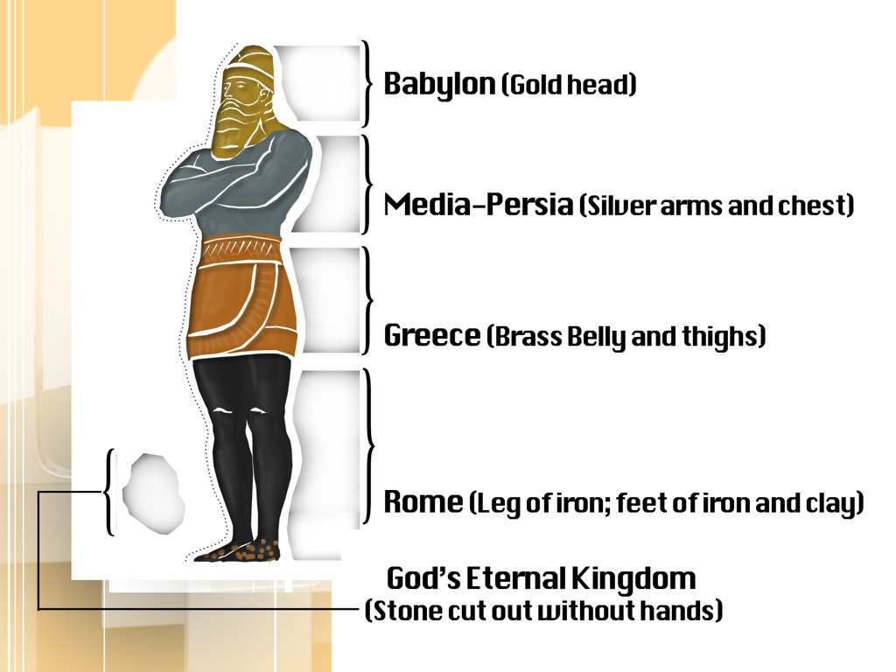
Nebuchadnezzar’s Dream
Daniel 2:43-45, Daniel predicts the date of the Messiah’s arrival
vv40-43, describe the Roman Empire
V44, “in the days of those kings the God of heaven will set up a kingdom which will never be destroyed…”
Jesus established the Kingdom represented by the great stone cut out of the mountain without hands that crushed the statue and became a great mountain that filled the whole earth (v35).

Slide 10
Healing Ministry
Psalm 146:7, 8-feeds the hungry, restores sight to the blind, raises up the humble
Isaiah 35:5-6-blind, see; deaf, hear; lame, leap like deer; mute, sing
Matthew 11:4-5, Jesus uses His signs as proof that He is the Messiah in response to John the Baptist’s inquiry
Triumphal Entry
Zechariah 9:9, Rejoice greatly, O daughter of Zion! Shout in triumph, O daughter of Jerusalem! Behold, your king is coming to you; He is just and endowed with salvation, Humble, and mounted on a donkey, Even on a colt, the foal of a donkey.
Matthew 21:6-9
Betrayal for 30 pieces of silver
Zechariah 11:12-13
Matthew 26:14-15, 27:3-10
Notes:
Not only was the amount of the betrayal foretold, but also references to what was done with the money after Judas felt remorse for what he had done. He threw the money into the temple sanctuary when they refused to accept the money back before he hung himself, and the chief priests used this “blood money” to purchase the “potter’s field” as a burial place for strangers.

Slide 11
Passover Lamb
Passover feast established, Exodus 12:21-27
Isaiah 53:7 compares the Messiah as a sacrificial lamb
Paul describes Christ as our Passover, I Corinthians 5:7
Passover lamb was not to have any bone broken, Exodus 12:46, Numbers 9:12
Psalms 34:20, prophesy that not a bone of Him would be broken
John 19:31-36, Then the Jews, because it was the day of preparation, so that the bodies would not remain on the cross on the Sabbath for that Sabbath was a high day), asked Pilate that their legs might be broken, and that they might be taken away. So the soldiers came, and broke the legs of the first man and of the other who was crucified with Him; but coming to Jesus, when they saw that He was already dead, they did not break His legs. But one of the soldiers pierced His side with a spear, and immediately blood and water came out. And he who has seen has testified, and his testimony is true; and he knows that he is telling the truth, so that you also may believe. For these things came to pass to fulfill the Scripture, “Not a bone of Him shall be broken.”

Slide 12
Crucifixion Prophesied
Isaiah 53:4-5, bore our griefs, carried our sorrows, pierced through for our transgressions, crushed for our iniquities, chastened for our well-being, and scourged for our healing.
Numerous references to His treatment including: scourging across the back, spitting in His face, striking Him, mocking (even the same words used to ridicule that were prophesied), stripped in humiliation, and divided His garments and cast lots for His clothing
Grouped with criminals
Isaiah 53:12, numbered with the transgressors
Luke 23:32-33
Pierced hands & feet
Psalm 22:16
John 20:27, Thomas witnesses the scars on Jesus’s hands and side
He would thirst and be given vinegar
Psalm 22:15 & Psalm 69:21
John 19:28 & Matthew 27:48

Slide 13
Prophesies Regarding Burial & Resurrection
Buried in a rich man’s tomb
Isaiah 53:9, grave was assigned with wicked men, but was with a rich man in His death
Matthew 27:57-60, Joseph of Arimathea, a rich man was granted to permission from Pilate to bury the body of Jesus in his own new tomb, hewn out of the rock
Resurrection
Psalm 16:10, For You will not abandon my soul to Sheol; Nor will You allow Your Holy One to undergo decay.
Hosea 6:1-2, raised up on the third day
Psalm 40:1-3, brought up from the pit of destruction
John 2:18-22, The Jews then said to Him, “What sign do You show us as your authority for doing these things?” Jesus answered them, “Destroy this temple, and in three days I will raise it up.” The Jews then said, “It took forty-six years to build this temple, and will You raise it up in three days?” But He was speaking of the temple of His body. So when He was raised from the dead, His disciples remembered that He said this; and they believed the Scripture and the word which Jesus had spoken.

Slide 14
Rock Solid Faith
I Corinthians 15:3-8
Christ died for our sins according to the Scriptures
He was buried, and was raised on the third day according to the Scriptures
He appeared to the disciples and to more than 500 brethren at once
John 20:30-31, many other signs Jesus performed in the presence of witnesses, not recorded, but these have been “so that you may believe that Jesus is the Christ, the Son of God; and that believing you may have life in His name”.
Notes:
Do you have “rock solid faith”? For years men have tried to destroy the credibility of the Bible, and yet this Holy Book has withstood all the scrutiny thrown at it. It has been written over a period of 1,600 years by 40+ authors of varying backgrounds from kings to fishermen, physicians to shepherds, tax collectors to Pharisees. Although times have changed drastically thru the course of human events and perspectives and knowledge of all these men were vastly different the common denominator is God. How much will you require to believe to the point of obedience? What can you take from this lesson to share with someone who doesn’t have this faith and are, perhaps, unaware of their emptiness Heath spoke of this morning. Will you empty yourself tonight and allow God to fill you up? Will you put to use in your life the suffering of Jesus for the forgiveness of your sins and be baptized for the remission of your sins?

