Slide 1
By Birth Or By Practice
Rom. 13:12b-14
Are we sinners by birth or are we sinners by practice?
Are we able to turn away from sin or are we unable?
Notes:
Play the slide show for this presentation to listen to the audio commentary by Peter Walsh and view slide timings. Or, click the sound icon on a slide for controls that you can use to hear the audio at your own pace.
A little organization will go a long way to enhancing your PowerPoint presentation.
Your title slide should be catching and relevant to your audience – offer something in the title that your audience wants.
Keep some basic principles in mind:
Your slides should complement what you have to say, not say it for you.
Keep slides direct and to the point - less is more!
Choose a background color or design that enhances and complements your presentation rather than competes with it.
Don’t get too fancy - a simple font, elegant color scheme and clear message is more important than lots of information (clutter!) on the slide.
Keep it simple! The purpose of the PowerPoint slide is to keep the mind of your audience focused – fewer words are better.
Note: You understand that Microsoft does not endorse or control the content provided in the following presentation.

Slide 3
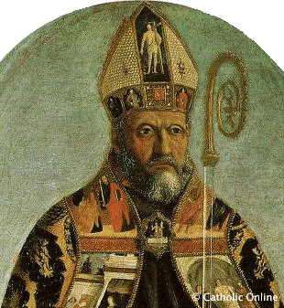
Augustine 354-430

Slide 5
Church Fathers After A. D. 100
Rejection of free-will is a view of heretics.
Free-will is a gift given by God.
Man has free-will because he is made in the image of God and God has free-will.

Slide 8
Five Points of Disagreement
Arminius/Remonstrants
*Predestination conditional
*Atonement universal
*Man cannot exercise faith
*Grace of God regeneration
*Believers able to resist, not beyond falling away
Calvin
*Total depravity
*Unconditional election
*Limited Atonement
*Irresistible grace
*Perseverance of saints

Slide 9
Pelegias . . . . . . . . . . . . . . . . . . . . . . . . . . . . Augustine
Arminius
Calvin
Notes:
Be sure that major headings are always in the same font, size and color – this provides your audience with a visual cue to where they are in the presentation.
Organize your thoughts before you start preparing your slides – too much mental clutter is as bad for your presentation as too much clutter on your slides.
Use the Animation Schemes to add interest – here the ‘Fade’ entrance animation is used to gradually reveal content.
Clarity is what your audience needs here so keep your message clear and focused. Keep your major slides brief – the slides are meant to summarize what you’re saying, not contain all your information.

Slide 10
Notes:
The black slide: Whenever I have a strong anecdote to tell I insert a black slide.
This technique:
Creates a black screen.
Automatically focuses the audience’s attention to the speaker.
Provides a sure way to emphasize a strong point or tell an important story.
Note: To create a black slide, on the Themes tab, under Theme Options, click Background and then click Format Background. On the Fill tab, under Solid, set black as the fill color. Click Apply to apply black to only the current slide. Or, instead of inserting a black slide, you can press the B key during the slide show to turn the screen black (or the W key to turn the screen white) to instantly pause the presentation and change the screen to black. Press B or W again to remove the black or white screen and continue your presentation.

