Slide 2
What Are You
Worth ?

Slide 3
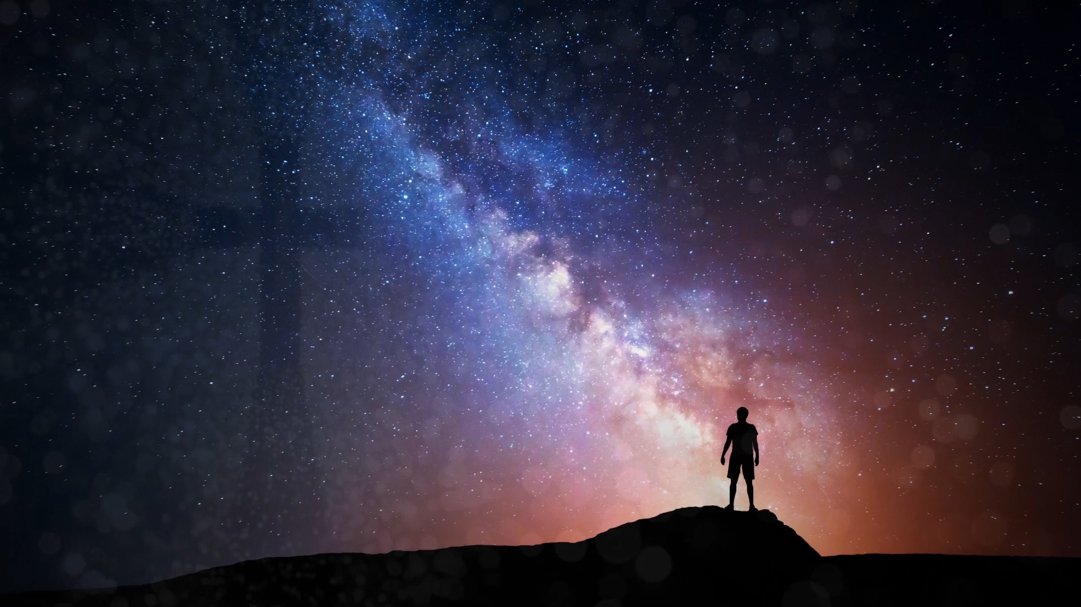
John 12:42-43 NASB
What Are You
“Never the less many even of the rulers believed in Him, but because of the Pharisees they were not confessing Him, for fear that they would be put out of the synagogue; for they loved the approval of men rather than the approval of God.”
Worth ?

Slide 4
Matthew 27:54 NASB
What Are You
“Now the centurion, and those who were with him keeping guard over Jesus, when they saw the earthquake and the things that were happening, became very frightened and said, “Truly this was the Son of God!”
Worth ?

Slide 5
Matthew 26:28 NASB
What Are You
“For this is My blood of the covenant, which is poured out for many for forgiveness of sins.”
Worth ?

Slide 6
Ephesians 1:7 NASB
What Are You
“In Him we have redemption through His blood, the forgiveness of our trespasses, according to the riches of His grace”
Worth ?

Slide 7
Galatians 5:1 NASB
What Are You
“You were bought with a price; do not become slaves of men.”
Worth ?
1 Corinthians 7:23 NASB
Numbers 3: 44-51
“It was for freedom that Christ set us free; therefore keep standing firm and do not be subject again to a yoke of slavery.”
Leviticus 25:47-55

Slide 8
1 Peter 1:18-21 NASB
What Are You
“Knowing that you were not redeemed with perishable things like silver or gold from your futile way of life inherited from your forefathers but with precious blood, as of a lamb unblemished and spotless, the blood of Christ.
For He was foreknown before the foundation of the world, but has appeared in these last times for the sake of you who through Him are believers in God, who raised Him from the dead and gave Him glory, so that your faith and hope are in God”
Worth ?

Slide 9
1 Corinthians 6:9-11 NASB
What Are You
“Or do you not know that the unrighteous will not inherit the kingdom of God? Do not be deceived; neither fornicators, nor idolaters, nor adulterers, nor effeminate, nor homosexuals, nor thieves, nor the covetous, nor drunkards, nor revilers, nor swindlers, will inherit the kingdom of God. Such were some of you; but you were washed, but you were sanctified, but you were justified in the name of the Lord Jesus Christ and in the Spirit of our God”
Worth ?

Slide 10
Galatians 2:20 NASB
What Are You
“I have been crucified with Christ; and it is no longer I who live, but Christ lives in me; and the life which I now live in the flesh I live by faith in the Son of God, who loved me and gave Himself up for me.”
Worth ?

