Slide 2
Gospel Meeting
Donnie V. Rader
dvrader@live.com

Slide 3
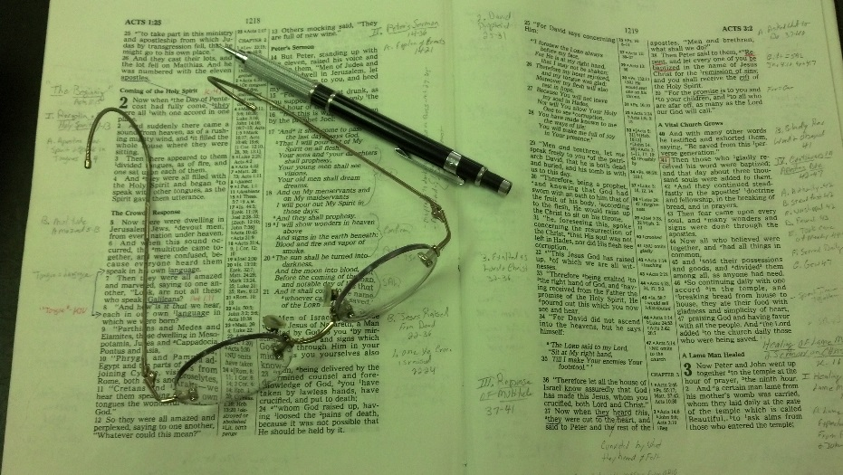
Topics
Friday: The Wayward Son Comes Home

Slide 4
Joseph
Favored son of Jacob (Gen. 37)
Brothers sold him to Midianite traders (Gen. 37)
Midianites sold him to Potiphar in Egypt (Gen. 37:36)
Rose in power & brought blessing to Potiphar’s house (Gen. 39:1-6)
Potiphar’s wife tried to seduce him (Gen. 39:7-18)

Slide 5
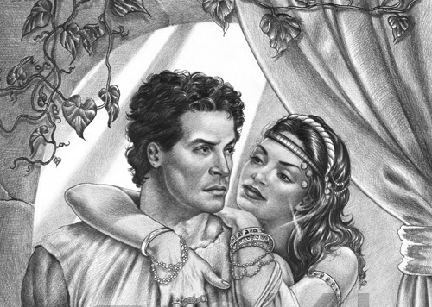
The Seduction
of Joseph
Gen. 39:7-23

Slide 6
She
Seduced
Him
He
Resisted
Her
Results That
Followed

Slide 7
The Seduction
of Joseph
The Temptation Was Strong

Slide 8
The Temptation Was Strong
His Youth
Age: 18-28 (cf. 37:2; 41:46, 1)
Are desires that are strong in youth (2 Tim. 2:22)
Time when desire may be the strongest (1 Cor. 7:9)
Learn: are young with faith & principle!

Slide 9
The Temptation Was Strong
His Youth
She Solicited Him
Not he seducing her!
She “cast longing eyes” on him (v. 7)
“looked with desire at Joseph” (NASB)
“began making eyes at Joseph” (LBP)
Flirt with her eyes (Prov. 6:25)
Or may mean: eye set to target him!

Slide 10
The Temptation Was Strong
His Youth
She Solicited Him
She Told Him How Far – Willing to Go
Not toying – flirting – only to tease
Said: “come lie with me” (v.7)
Few young men in Egypt could resist!

Slide 11
The Temptation Was Strong
His Youth
She Solicited Him
She Told Him How Far – Willing to Go
Repetition of It
Resisting first instance – not too hard
Eve resisted at first – then yielded (Gen. 3:1-6)
Samson resisted Delilah (Judges 16)
Continual and daily (v. 10)
Designed to wear him down (Prov. 6:26)

Slide 12
The Temptation Was Strong
His Youth
She Solicited Him
She Told Him How Far – Willing to Go
Repetition of It
Convenient Opportunity
Fact – easily get caught is a deterrent
Master gone – no one else around (v.11)
Being alone is enticing (Prov. 7:19-20)
Danger: being alone with no one around!!

Slide 13
The Temptation Was Strong
His Youth
She Solicited Him
She Told Him How Far – Willing to Go
Repetition of It
Convenient Opportunity

Slide 14
The Seduction
of Joseph
The Temptation Was Strong
The Resistance Was Firm

Slide 15
The Resistance Was Firm
Resisted With Words (vv. 8-9)
Said “NO” (vv. 8, 10)
Spoke of trust (v. 8)
Recalled sacredness of marriage (v. 9)
Called it wickedness [evil] (v. 9)
Called it sin against God (v. 9)

Slide 16
The Resistance Was Firm
Resisted With Words (vv. 8-9)
Resisted With Deeds (vv. 10-11)
Refused to be with her (v. 10)
“or even be with her (NIV)
“kept out of her way as much as possible” (LBP)
Understood danger of association
Hang around – could easily lead to…
Prov. 5:8 – do not go near the door of her…

Slide 17
The Resistance Was Firm
Resisted With Words (vv. 8-9)
Resisted With Deeds (vv. 10-11)
Refused to be with her (v. 10)
Fled and ran outside (v. 12)
Literally!
Removed himself from temptation
Actions showed his words were real
May have to leave – house, car, room, etc.

Slide 18
The Resistance Was Firm
Resisted With Words (vv. 8-9)
Resisted With Deeds (vv. 10-11)
Resisted Promptly (vv. 8, 12)
Without the slightest hesitation
Without any dallying with the temptation
No waiting to see how far this may go

Slide 19
The Resistance Was Firm
Resisted With Words (vv. 8-9)
Resisted With Deeds (vv. 10-11)
Resisted Promptly (vv. 8, 12)
Resisted Firmly (vv. 8-10)
No wavering
No indecision
No pushing aside something that he secretly desired
Said “no” and meant it!

Slide 20
The Resistance Was Firm
Resisted With Words (vv. 8-9)
Resisted With Deeds (vv. 10-11)
Resisted Promptly (vv. 8, 12)
Resisted Firmly (vv. 8-10)

Slide 21
The Seduction
of Joseph
The Temptation Was Strong
The Resistance Was Firm
The Results Were Clear

Slide 22
The Results Were Clear
See the Difference and Love and Lust
The woman lusted for him – did not love him!
Evidence: her lie & effort to destroy him (vv. 14-ff)
“But indeed all illicit passion, whether gratified or baulked, has a tendency sooner or later to become transformed into hate” (Pulpit)
One who lust after you – not necessarily love you!
Lust seek gratification
Love cares about the person

Slide 23
The Results Were Clear
See the Difference and Love and Lust
See What He Lost
Lost his coat (vv. 12-13)
Lost his job (v. 20)
Lost his freedom (v. 20)
Lost his standing / approval of man (vv. 14-23)
You may lose: boyfriend, girlfriend, standing among “friends”

Slide 24
The Results Were Clear
See the Difference and Love and Lust
See What He Lost
See What He Kept
Kept his purity
Kept his honor (Prov. 6:33)
Kept his conscience
Kept his reputation among the godly
Kept his relationship with God (vv. 21-23)

Slide 25
The Results Were Clear
See the Difference and Love and Lust
See What He Lost
See What He Kept

Slide 26
The Seduction
of Joseph
The Temptation Was Strong
The Resistance Was Firm
The Results Were Clear

